Slide 1
AUTHENTICATION AND ENCRYPTION SYSTEM FOR ONLINE BANKING SYSTEM
V. Thirupathirao.(192211896)
SK. Jani Basha.(192211136)
FACULTY:-DR. G. Jayandhi

Slide 2
INTRODUCTION
**Authentication** checks that the person trying to access an account is really who they say they are. This can be done with:
- Passwords: A secret word or phrase only the user knows.
- Biometrics: Unique physical features like fingerprints or facial recognition.
- Two-Factor Authentication (2FA): A second form of ID, like a code sent to the user’s phone.
**Encryption** protects the data itself. It changes information into a code that only someone with the right key can read. This way, even if hackers intercept the data, they can’t understand it. Common encryption methods include:
- Advanced Encryption Standard (AES): A strong encryption method.
- Secure Socket Layer (SSL): Protects data during transmission.
-> Together, these systems keep online banking safe by:
- Making sure only authorized users can access accounts.
- Protecting data from being read by unauthorized people.
- Preventing fraud and data breaches.->

Slide 3
PROBLEM STATEMENT
Online banking, also known as internet banking, enables customers to conduct financial transactions through a financial institution's website. Common features of online banking include:
- **Non-transactional tasks**:
1. Viewing account balances
2. Viewing recent transactions
3. Downloading bank statements (e.g., in PDF format)
4. Viewing images of paid cheques
5. Ordering cheque books
6. Downloading periodic account statements
7. Downloading applications for M-banking, E-banking, etc.

Slide 4
PROPOSED DESIGN WORK
1.Identifying the key components.
-> Public Key Infrastructure (PKI).
-> Symmetric and Asymmetric Encryption:
-> Hash Functions
-> Key Management
2.Functionality:
-> PKI (Public Key Infrastructure)
-> Encryption Algorithms
-> Key Management
3. Architectural Design.
->Key Components
-> Security and Cryptography Mechanisms

Slide 5
1.Identifying the key components
-> Public Key Infrastructure (PKI):
Used for secure key exchange, digital signatures, and certificate management.
In online banking, PKI facilitates the issuance and management of digital certificates used for authentication and encryption.
->Symmetric and Asymmetric Encryption:
Symmetric encryption is used for encrypting large volumes of data efficiently, while asymmetric encryption is employed for key exchange and digital signatures.
AES is commonly used for symmetric encryption, while RSA is popular for asymmetric encryption.

Slide 6
Hash Functions:
Cryptographic hash functions like SHA-256 are used for data integrity verification.
Hashing ensures that data transmitted between the user's device and the bank's server remains unchanged during transit.
Key Management:
Proper key management practices are crucial for securely generating, storing, and exchanging encryption keys.
Key rotation, key escrow, and key revocation mechanisms are implemented to enhance security.

Slide 7
2.Functionality:
->PKI (Public Key Infrastructure)
- Manages digital certificates for secure communication.
- CAs issue digital certificates to verify identities.
- Ensures secure communication channels.
->Encryption Algorithms
- AES: Symmetric encryption for secure data storage and transmission.
- RSA: Asymmetric encryption for secure key exchange and digital signatures.
->Key Management
- Key Rotation: Regular key updates to reduce compromise risk.
- Key Escrow: Secure storage and recovery of encryption keys.

Slide 8
3. Architectural Design.
-> Key Components
1. Client-Side Architecture
- User-Friendly Interface
- Provides customers access to their accounts.
- Enables various banking activities. - Encrypt sensitive data (e.g., login credentials, transaction details) before transmission.
- Protects data during transit over insecure networks.
2. Server-Side Architecture
- Transaction Processing
- Data Management
- Security and Compliance
-> Security and Cryptography Mechanisms
1. Public Key Infrastructure (PKI)
- Manages digital certificates.
- Facilitates secure key exchange.
2. Encryption Layers
- Utilizes symmetric and asymmetric encryption algorithms.
- Ensures data is secure both at rest and in transit.
3. Key Management System
- Secure generation, distribution, rotation, and storage of encryption keys.
- Enhances data confidentiality and integrity.

Slide 9
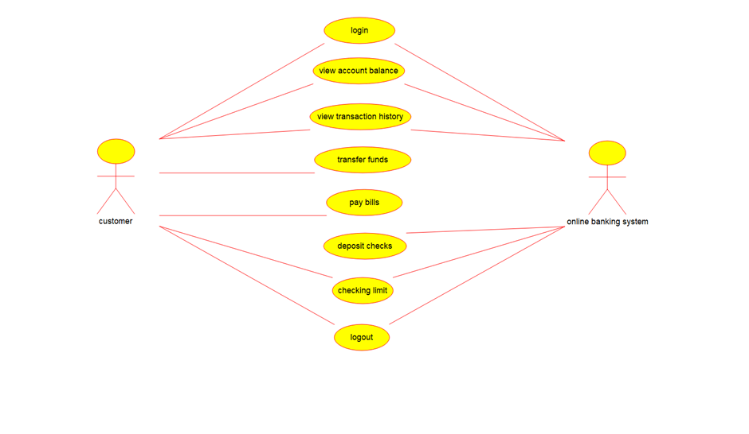
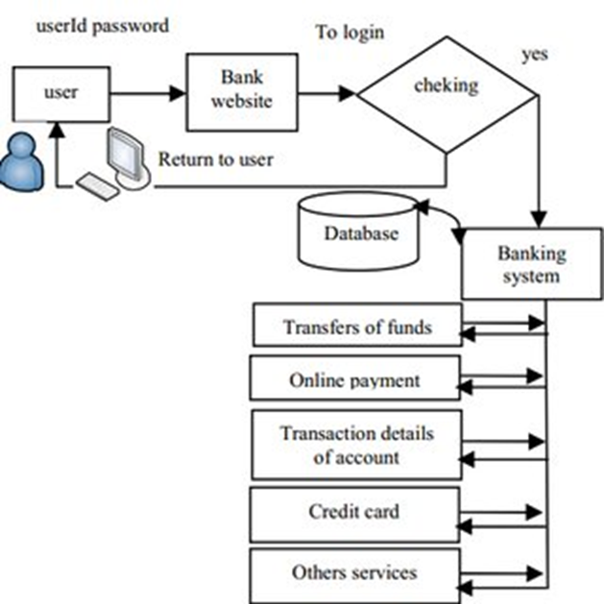
UI DESIGN OF BANKING
SYSTEM
ARCHITECURE DIAGRAM

Slide 10
IMPLEMENTATION OF ALGORITHM
**Authentication Algorithms:**
1. **Password-based Authentication:**
- **PBKDF2:** Enhances password security by adding a salt (random data) and performing many iterations to make it harder for attackers to crack.
2. **Biometric Authentication:**
- **Fingerprint Recognition:** Compares unique fingerprint patterns.
- **Facial Recognition:** Analyzes and matches facial features.
3. **Two-Factor Authentication (2FA):**
- **TOTP:** Generates a temporary code that changes every 30 seconds.
- **HOTP:** Creates a one-time password based on a counter.
**Encryption Algorithms:**
1. **Symmetric Encryption:**
- **AES:** Encrypts data in blocks using a key. It’s very secure and widely used.
- **DES:** An older method now replaced by AES, encrypts data in smaller blocks.
2. **Asymmetric Encryption:**
- **RSA:** Uses a public key for encrypting data and a private key for decrypting it.
- **ECC:** Provides strong security with shorter keys, making it efficient for mobile devices.
3. **Hash Functions:**
- **SHA-256:** Creates a 256-bit fixed-length string from data, used for verifying data integrity.
- **MD5:** Creates a 128-bit fixed-length string, but it’s less secure and being replaced by better options like SHA-256.

Slide 11
Conclusion
The current authentication and encryption systems for online banking play a crucial role in securing users' financial information. While these systems offer significant protection against unauthorized access and data breaches, they are not without drawbacks. Password-based authentication is vulnerable to weak passwords and phishing attacks. Biometric systems face privacy concerns and spoofing risks. Two-factor authentication can be inconvenient and is not immune to advanced phishing techniques. Encryption, while effective, introduces performance overhead and requires robust key management.

Slide 12
Future Enhancements
Enhanced Biometric Authentication:
Multi-modal Biometrics: Combining multiple biometric factors (e.g., fingerprint and facial recognition) to improve accuracy and security.
Liveness Detection: Implementing advanced techniques to ensure the biometric data is from a live person and not a spoof.
Improved Two-Factor Authentication:
Physical Security Keys: Using hardware tokens like YubiKeys for 2FA, which are more resistant to phishing.
Push Notifications: Utilizing app-based notifications instead of SMS for 2FA to mitigate SIM swapping risks.
Password Alternatives:
Password less Authentication: Adopting methods like email-based links or biometrics to eliminate the need for passwords.
Behavioral Biometrics: Using patterns in user behavior (e.g., typing speed, mouse movements) to authenticate users.
Advanced Encryption Techniques:
Post-Quantum Cryptography: Developing algorithms that are resistant to potential future quantum computing attacks.
Homomorphic Encryption: Allowing data to be processed without decrypting it, enhancing security in data processing.

Slide 13


